Slide 1
Revature
Project 1
MapReduce/JavaDoc
Michael J. Rashidian

Slide 2
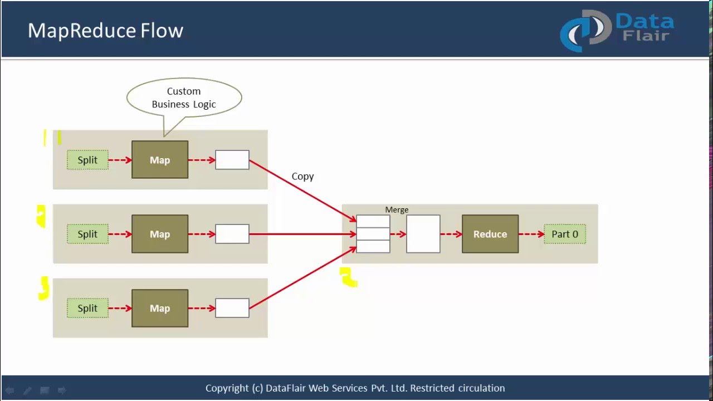
Overview
Starting Ideas
Tasks 1 - 4 Logic
Task 5 MR Logic (unfinished)
If I had more time . . .

Slide 3


1. Starting Ideas
Confusing data.
Veracity Is it Null deliberately?
Delimiters - Readability
Volume About 58MB
Variety Text, numbers, null,

Slide 4
Tasks 1 - 4 Assumptions
Null means unavailable
Graduate is higher edu
JavaDocs needed so others can implement
Employment should be by country
Education increase is old - new
Tip
In this example, we’re leading off with something unexpected.
While the audience is trying to come up with a number, we’ll surprise them with the next slide.

Slide 5
If I had more time . . . .
#1. Linear Regression
#2. Predictive Analysis
#3. Charts
Tip
Remember, linear regression isn’t as complicated as it soundst.
Multiple aspects of linear regression

Slide 6
Conclusion/Findings
MapReduce is complicated, but a powerful tool, provides a solid framework for development, BUT . . .
No calculation is too simple
Project Limits (Scope) Basic data set has alot of possibility..
How does this affect you? .Leverage your peer knowledgebase.
Contribute your skills
Prepare for the next project

